Slide 1
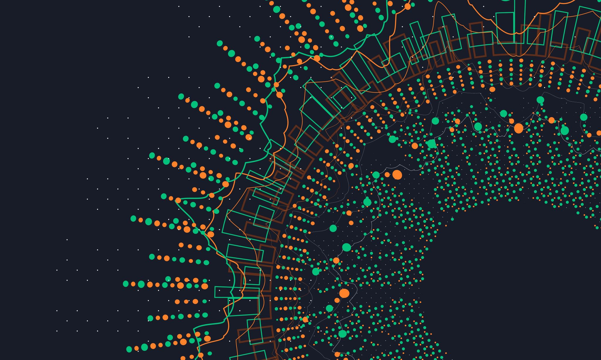
Analytical CRM Development for a Bank SQL & POWER BI
Vaibhav Prakash Gupta
17 March 2024

Slide 2

INTRODUCTION
OBJECTIVE WITH PROBLEM STATMENT
BANK ANALYSIS DATA SNAPSHOT
KEY DATA ELEMENTS
ANALYTICS APPROACH AND TOOLS
STRATEGIES FOR CUSTOMERS INCREASING
STRATEGIES FOR DECREASING CHURN RATE
INSIGHTS AND RECOMMENDATIONS
DASHBOARD
CONCLUSION

Slide 3

Introduction
In today's competitive banking landscape, customer retention, service quality, and satisfaction are paramount to success. Recognizing this, [Bank Name] has embarked on a strategic initiative to reduce customer churn, enhance service delivery, and elevate overall customer satisfaction levels. As part of this endeavor, the bank has provided comprehensive datasets encompassing various facets of customer interactions, demographics, and behaviors.

Slide 4
Objectives with Problem Statement
Analyze historical data of bank to identify patterns, trends, and emerging issues in bank activities.
The bank aims to reduce customer churn, improve service delivery, and enhance customer satisfaction. They have provided you with datasets including customer demographics, transaction details, customer exit information, and active customer profiles.

Slide 5
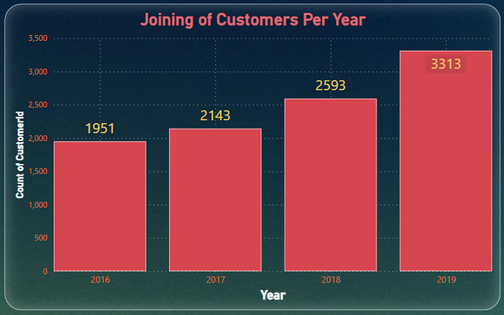
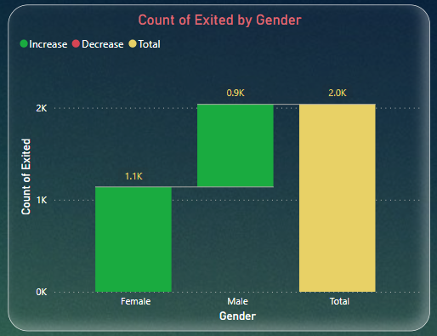
Bank analysis data snapshot
There are 10 Thousands of customers in the bank according to data. And 7963 number of customers those retain in bank and 2037 customers exit the Bank.
As per the Analysis Every year the ratio of joining of customers was increases, In year 2016 joined 1951 customers and 3313 customers joined in year 2019 .
7055 customers have Credit Card, and 2945 customers don’t have credit card From 2016 to 2019.
In Male 898 customers exit the bank, and in Female 1139 customers exit the bank.

Slide 6
Key DATA ELEMENTS
Geography: There are three country come in this column according to given data that was Germany, France and Spain.
Exited: In the Exited column 1 for those who exit the bank and 0 for those who Retain with bank continuously.
Salary: It indicates that salary of the customers.
Date : Indicating the date when the customers was joining the bank, enabling temporal analysis and trend identification.
Has Credit Card: This column indicating the who have credit card or not.
Credit Scores: This column shows the who have credit card pay the EMI or Money on Particular time or not.

Slide 7
Analytics Approach and tools
Data Cleaning: Utilized functions like Split Column, Trim, and Remove Duplicate to ensure data accuracy.
Assessing the frequency of customers :
Total Customers = COUNT (Bank[CustomerId]).
Formula for Churn Rate :
=DIVIDE(CALCULATE(COUNTROWS('try bank'),'try
bank'[Exited] = "Exit"), CALCULATE(COUNTROWS
('try customerinfo'),'try customerinfo'[Gender]=
"Female" ),0)
Formula for Outliers Range :
Outliers Range = [Quartile Q3]+1.5*[Inter
Quartile Range]

Slide 8
Strategies for Customers increasing
Market Segmentation and Targeting: Identify specific market segments with high potential for growth, such as young professionals, small business owners, or retirees. Tailor marketing efforts and product offerings to meet the needs and preferences of each segment.
Promotional Campaigns
Enhanced Customer Experience
Product Innovation
Partnerships and Alliances
Educational Workshops and Seminars
Referral Programs
Community Involvement
Data Analysis and Personalization

Slide 9
Strategies for decreasing Churn RATE
Reducing churn rate, which refers to the percentage of customers who stop using a service or product over a given period, is crucial for the long-term sustainability and profitability of a bank. Here are some strategies to decrease churn rate:
Improve Customer Service
Personalized Engagement
Enhance Product and Service Offerings
Streamline Onboarding Process
Proactive Communication
Monitor Customer Behavior
Incentivize Loyalty
Exit Surveys and Feedback

Slide 10
Customer Segmentation: Analyzing customer data reveals distinct segments with varying needs, behaviors, and preferences. Understanding these segments allows for targeted marketing efforts and personalized engagement strategies.
Churn Predictors: Certain customer behaviors or characteristics serve as predictors of churn, such as declining activity levels, negative feedback, or life events. Identifying these indicators early allows for proactive intervention to retain at-risk customers.
Personalized Marketing Campaigns: Leverage customer segmentation insights to tailor marketing campaigns and promotions to specific customer segments. Deliver targeted messages and offers that resonate with each segment's preferences and needs, increasing engagement and loyalty.
Proactive Customer Outreach: Utilize churn predictors to identify customers at risk of leaving and implement proactive outreach initiatives. Offer personalized incentives, support, or solutions to address their concerns and retain their business.
Insights
&
RECOMMENDTION

Slide 11
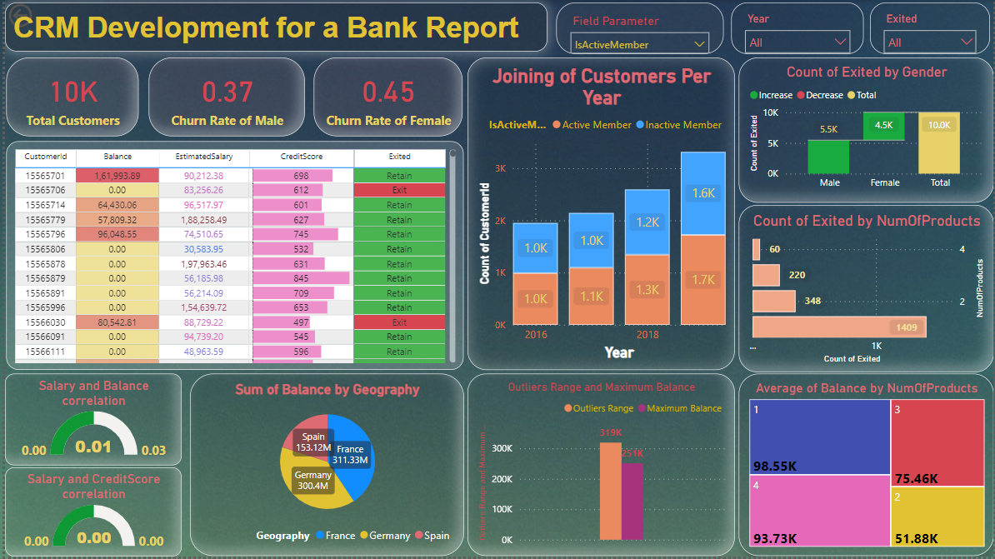
DASHBOARD-1

Slide 12
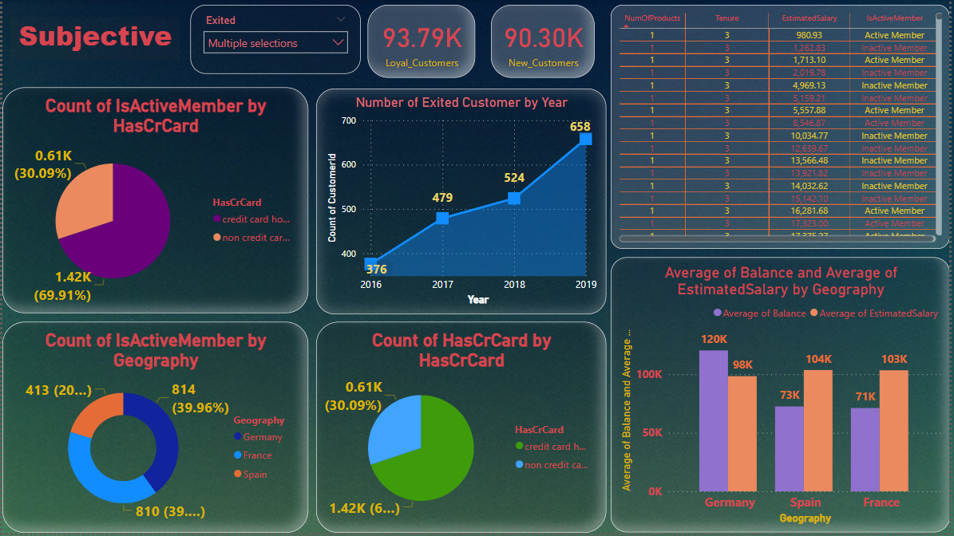
DASHBOARD-2

Slide 13

CONCLUSION
In conclusion, reducing churn rate is essential for banks to maintain a loyal customer base, drive long-term profitability, and sustain growth in a competitive market. By implementing a combination of strategies focused on enhancing customer service, personalizing engagement, improving product offerings, streamlining processes, and proactive communication, banks can effectively decrease churn rate and foster lasting relationships with their customers.
It's crucial for banks to continuously monitor customer behavior, gather feedback, and adapt their strategies to meet evolving customer needs and preferences. By prioritizing customer satisfaction and loyalty, banks can differentiate themselves from competitors, build trust with their customers, and ultimately achieve sustainable success in the banking industry.
Ultimately, the journey towards reducing churn rate requires a commitment to excellence in customer service, innovation, and continuous improvement. By prioritizing the needs of their customers and delivering value at every touchpoint, banks can create meaningful connections that withstand the test of time and drive long-term success.

Slide 14


